Slide 1


Slide 2


Slide 3
Some Key Climate Messages

Slide 4
Summary
The “Man-made Climate Crisis” is a fraud. Natural cycles control the climate.
“Net Zero Emissions” is a destructive, impossible green dream.
Hydrogen, Pumped Hydro and Big Batteries are all net-consumers of energy. They can store energy and recycle it, but that round-robin process is always a net consumer of energy.
Carbon Capture and Storage and “Clean Coal” are con games designed to consume more hydrocarbon-generated energy for no public or environmental benefit. They enrich big businesses at end-consumers’ expense.
Reliable, affordable electricity for industry and homes is best supplied by coal, gas, hydro or nuclear power.
Like UK with shale oil and gas deposits currently; while much of the rest of the developing world scrambles to exploit sources of cheap, reliable energy to power economic growth, developed world politicians & bureaucrats have delayed uranium mining & exploitation, coal exploration and development for decades. Such follies must stop.
All electricity generators should be treated equally – no special taxes or subsidies. They should be obliged to provide their own backup power and their own connections to the grid
Electric cars may suit rich city dwellers (who forget they are powered mainly by gas in the UK). But battery-electric engines are an impossible dream for dozers, tractors, harvesters, HGVs, aeroplanes and bulk carriers. And the supply chains that deliver daily food, fuel and services to the cities rely totally on hydrocarbon energy (diesel, petrol and gas).

Slide 5
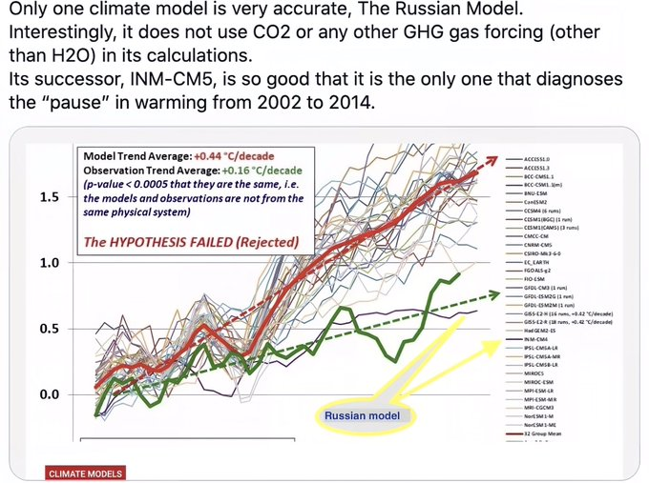
Fig.1: “Hot-Rod” Climate Models

Slide 6
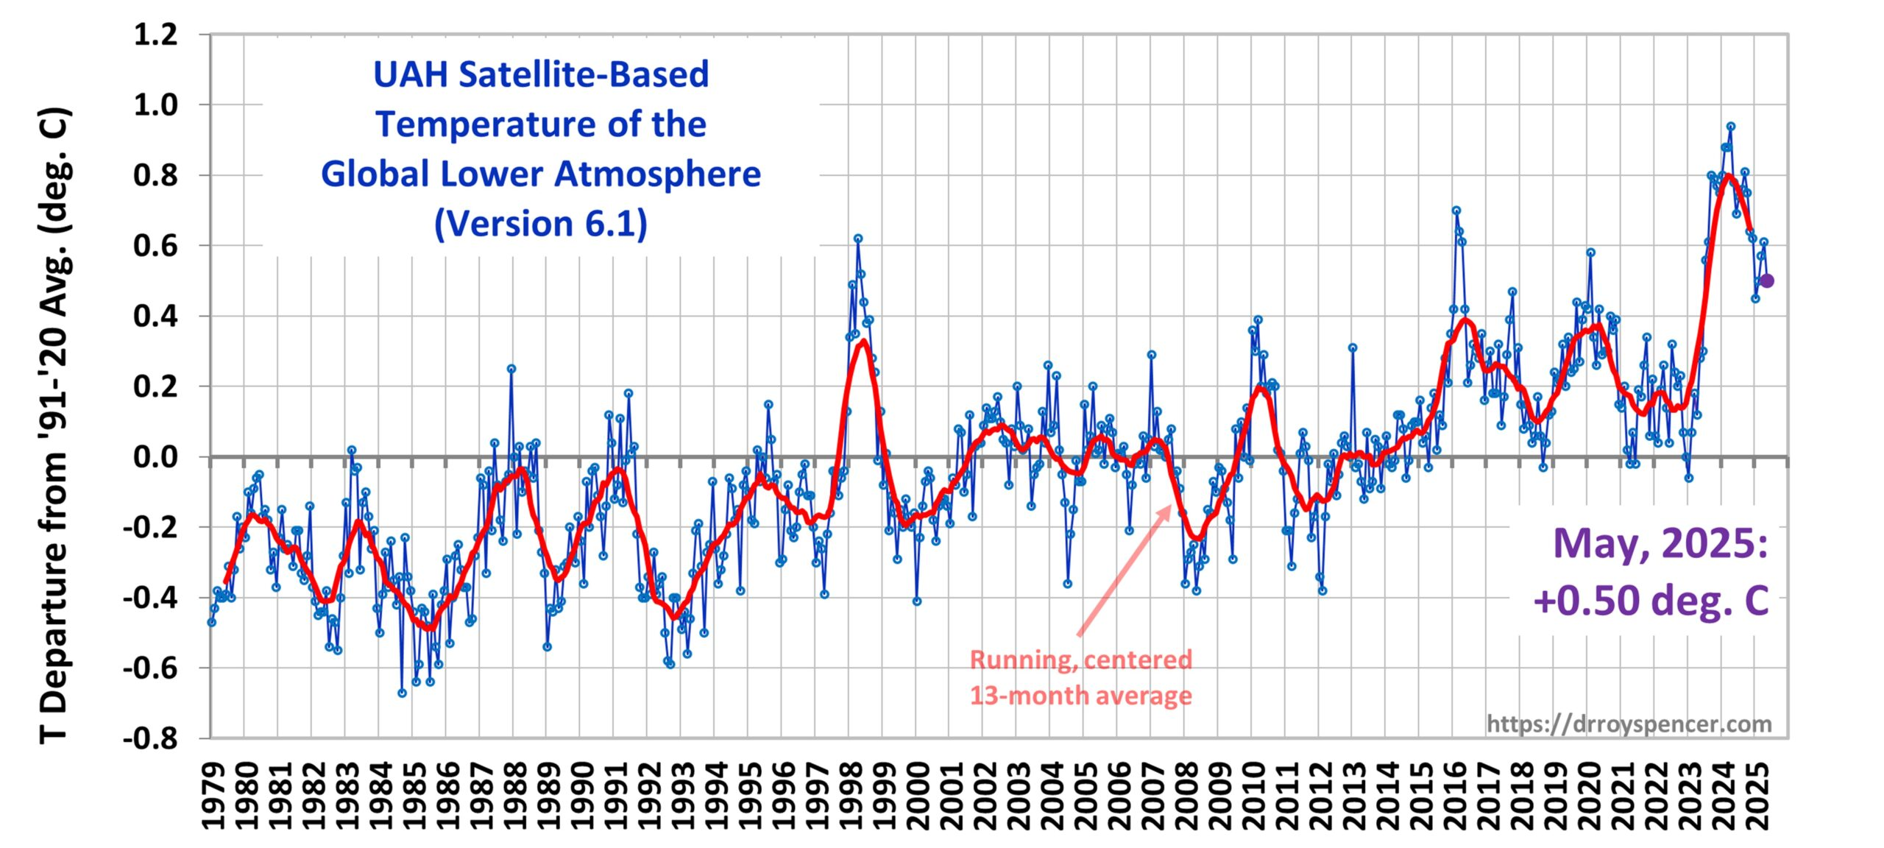
Fig.2: 46 years average global temperature data by month
From here: https://www.drroyspencer.com/latest-global-temperatures/

Slide 7
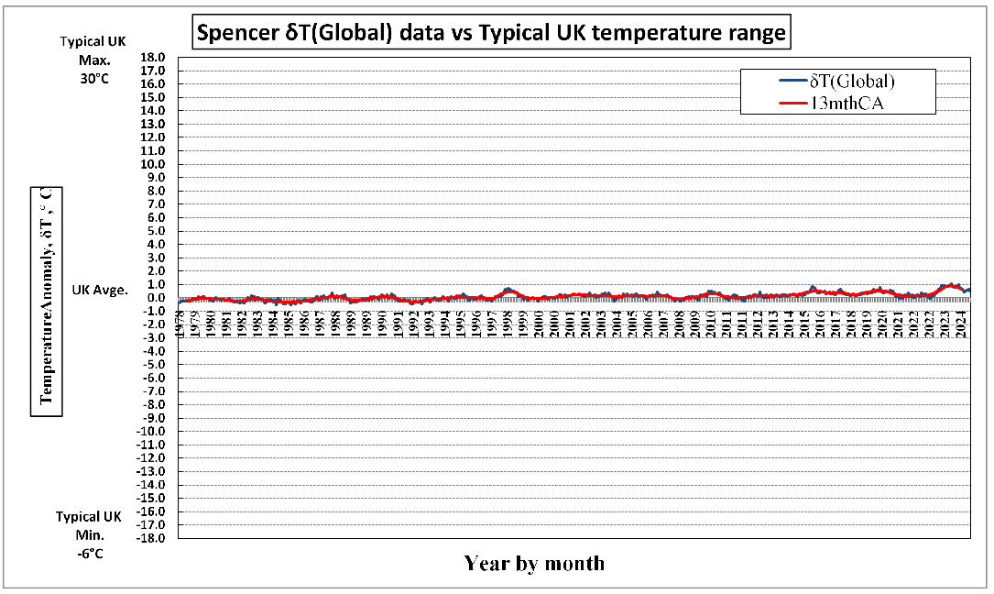
Fig.3: Putting recent warming in rational perspective
Data source: https://www.drroyspencer.com/latest-global-temperatures/

Slide 8
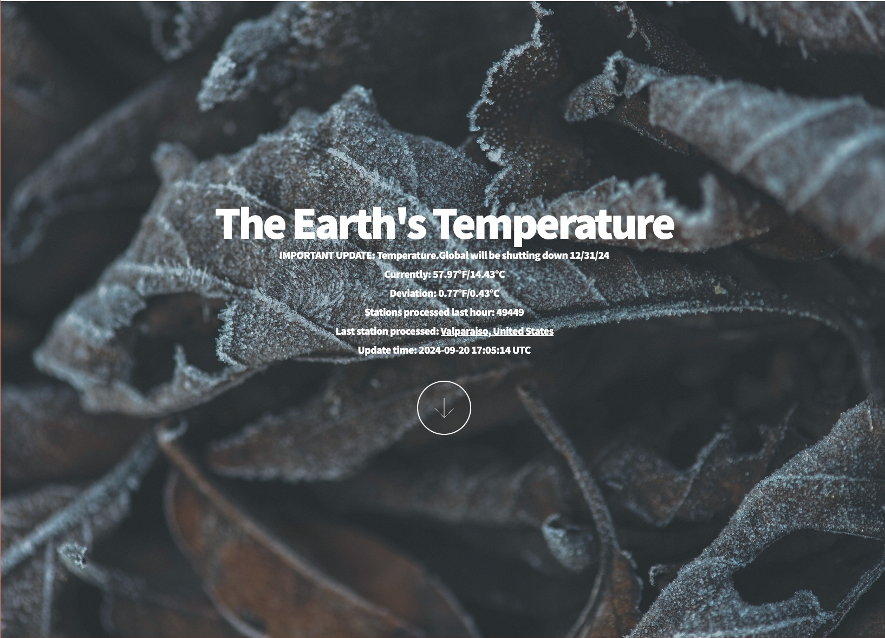
Fig. 4: How close are we to “global boiling”, then?
Despite blatant NASA/ NOAA temperature data record falsification, scientifically-valid evidence of “global boiling” is notable for its absence (see: https://temperature.global/):14.4°C average temperature from 49,499 temperature readings; only 85.6°C to go!!!

Slide 9
Fig.5: Temperature variation since 1750 reproduced by superposing De Vries-Suess solar & AMOC/ PDO oceanic activity cycles
Nearly all the observed temperature variation since 1750 can be accounted for by superposing:
1. The (c.200 year) de Vries-Suess solar activity cycle, &
2. The (c.65 year) AMO/ PDO oceanic cycle (effect of solar activity on the Atlantic & Pacific oceans; modulated by oceanic specific heat capacity; hence time-delayed)
References:
1. http://ruby.fgcu.edu/courses/twimberley/envirophilo/devries.pdf
2. https://notalotofpeopleknowthat.wordpress.com/2013/10/21/amo-pdo-cycles/
3. https://wattsupwiththat.com/2013/12/17/solar-amo-pdo-cycles-combined-reproduce-the-global-climate-of-the-past/
4. https://schillerinstitute.com/media/carl-otto-weiss-le-changement-climatique-est-du-a-des-cycles-naturels/
5. https://www.metoffice.gov.uk/weather/learn-about/weather/oceans/amoc
6. https://www.metoffice.gov.uk/weather/learn-about/weather/oceans/pacific-decadal-oscillation
7. de Vries-Suess cycle: https://link.springer.com/article/10.1007/s11207-021-01822-4

Slide 10
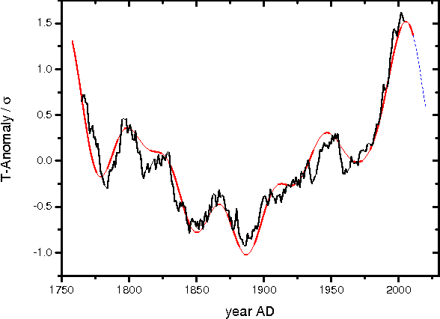
Fig.6: Temperature variation since 1750 reproduced by superposing DeVries-Suess solar & AMOC/PDO oceanic activity cycles
Black = Observed Temperatures
Red = De Vries/AMO-PDO (DVAP) Superposition
Purple = Projected DVAP future trend
H.-J. Luedecke, A. Hempelmann & C.O. Weiss: Page 451, Fig.6: “Multi-periodic climate dynamics: spectral analysis of long-term instrumental and proxy temperature records”; Climate of the Past: https://www.semanticscholar.org/paper/Multi-periodic-climate-dynamics%3A-spectral-analysis-L%C3%BCdecke-Hempelmann/12a0363dd89267f4d5d07bf6fa94e30f70a4b6ad. This Grand Solar Minimum view is shared by Profs. Habibullo Abdussamatov, Nils-Axel Mörner & Valentina Zharkova.

Slide 11
Fig.7 - Geothermal Climate Influences?
Magnetospheric Effects - currently weakening field; pole shift within next 10,000 years: reducing protection from solar effects. Cosmic rays largely too energetic to be affected
Volcanicity/ Tectonics - highest energy cosmic rays allegedly penetrate to Earth’s core before being absorbed: heating magma and promoting volcanic activity/ post-eruption atmospheric cooling/ earthquakes
See: e.g., Svalbard & Thwaites Glacier geothermal plumes: https://www.tohoku.ac.jp/en/press/greenland_plume_drive_thermal_activities.html?mc_cid=fb29760038&mc_eid=ffa2d4f35e & https://www.nature.com/articles/s43247-021-00242-3
El Niño/ La Niña - significant, recurring temporary warming/cooling effects over large oceanic areas:
See e.g.: https://www.worldatlas.com/articles/how-do-ocean-currents-affect-climate.html & https://www.britannica.com/science/climate-meteorology/Circulation-currents-and-ocean-atmosphere-interaction
The Beaufort Gyre - Large climate swings may be triggered by the waxing and waning this phenomenon; which has the potential to disrupt the Gulf Stream & the mild Western European climate of the current era.
See: https://electroverse.net/british-astrophysicists-mini-ice-age-is-accelerating-new-maunder-minimum-has-begun/

Slide 12
Fig.8: Geothermal Oceanic Warming
Latest research suggests geothermal heat evolution from subaquatic volcanoes is responsible for the recently observed dramatic oceanic temperature increases
Geothermal flux is the dominant thermodynamic driver - the ∆T gradient - of global climate change.":
https://x.com/EthicalSkeptic/status/1919156533264318885
Heat Hysteria: A Manufactured Crisis Built On Asphalt; 100 Years of Spanish Rainfall Data Destroys The Climate Narrative; + Was It Earth’s Internal Heat That Drove Recent Ocean Warming?
https://electroverse.info/heat-hysteria-a-manufactured-crisis-built-on-asphalt-100-years-of-spanish-rainfall-data-destroys-the-climate-narrative-was-it-earths-internal-heat-that-drove-recent-ocean-warming/

Slide 13
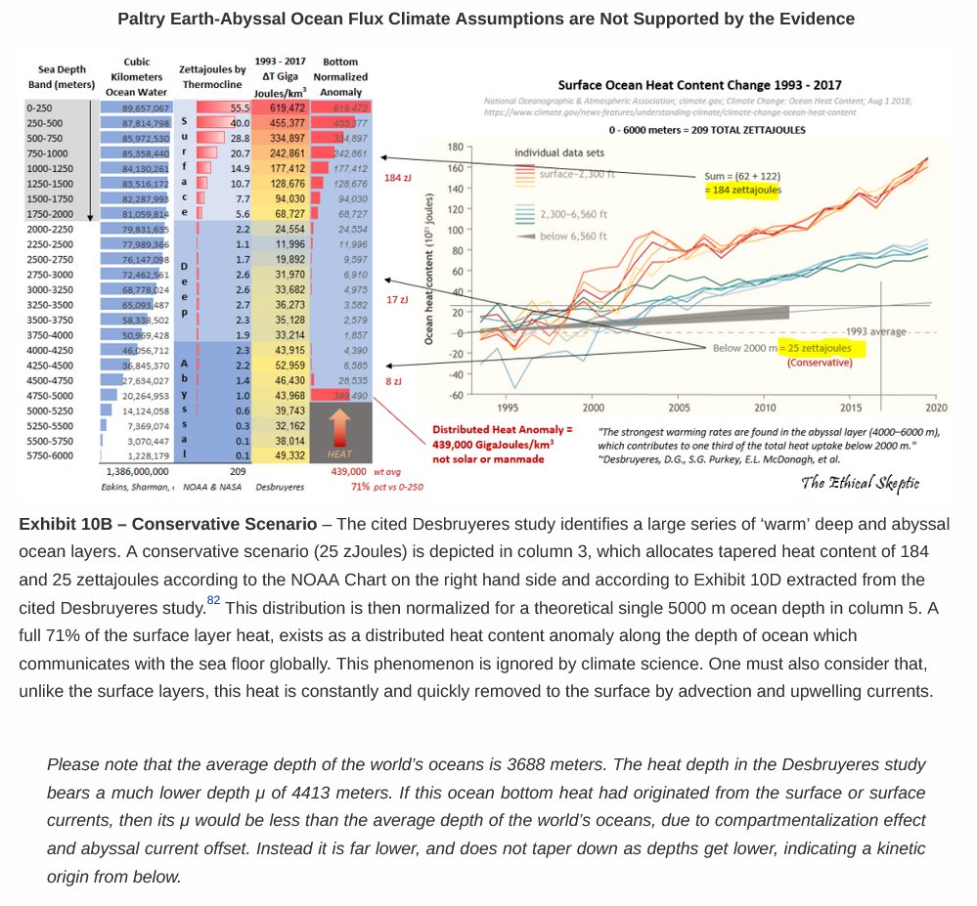
Fig.9: The “Frog” is being boiled from the inside out, not vice versa

Slide 14
Fig.10: The Dominant Driver?
There are estimated to be some 60,000 subaquatic volcanic sites around the 25,000 mile terrestrial volcanic ‘Ring of Fire’; a currently unknown number of which are active, as opposed to dormant or extinct.
If even 0.14% or less of the ocean floor exhibits 10,000 Watts/m² spike zones along tectonic ridges and its estimated 60,000 hot spots, this positions the geothermal flux to be the dominant thermodynamic driver - the ∆T gradient - of global climate change.

Slide 15
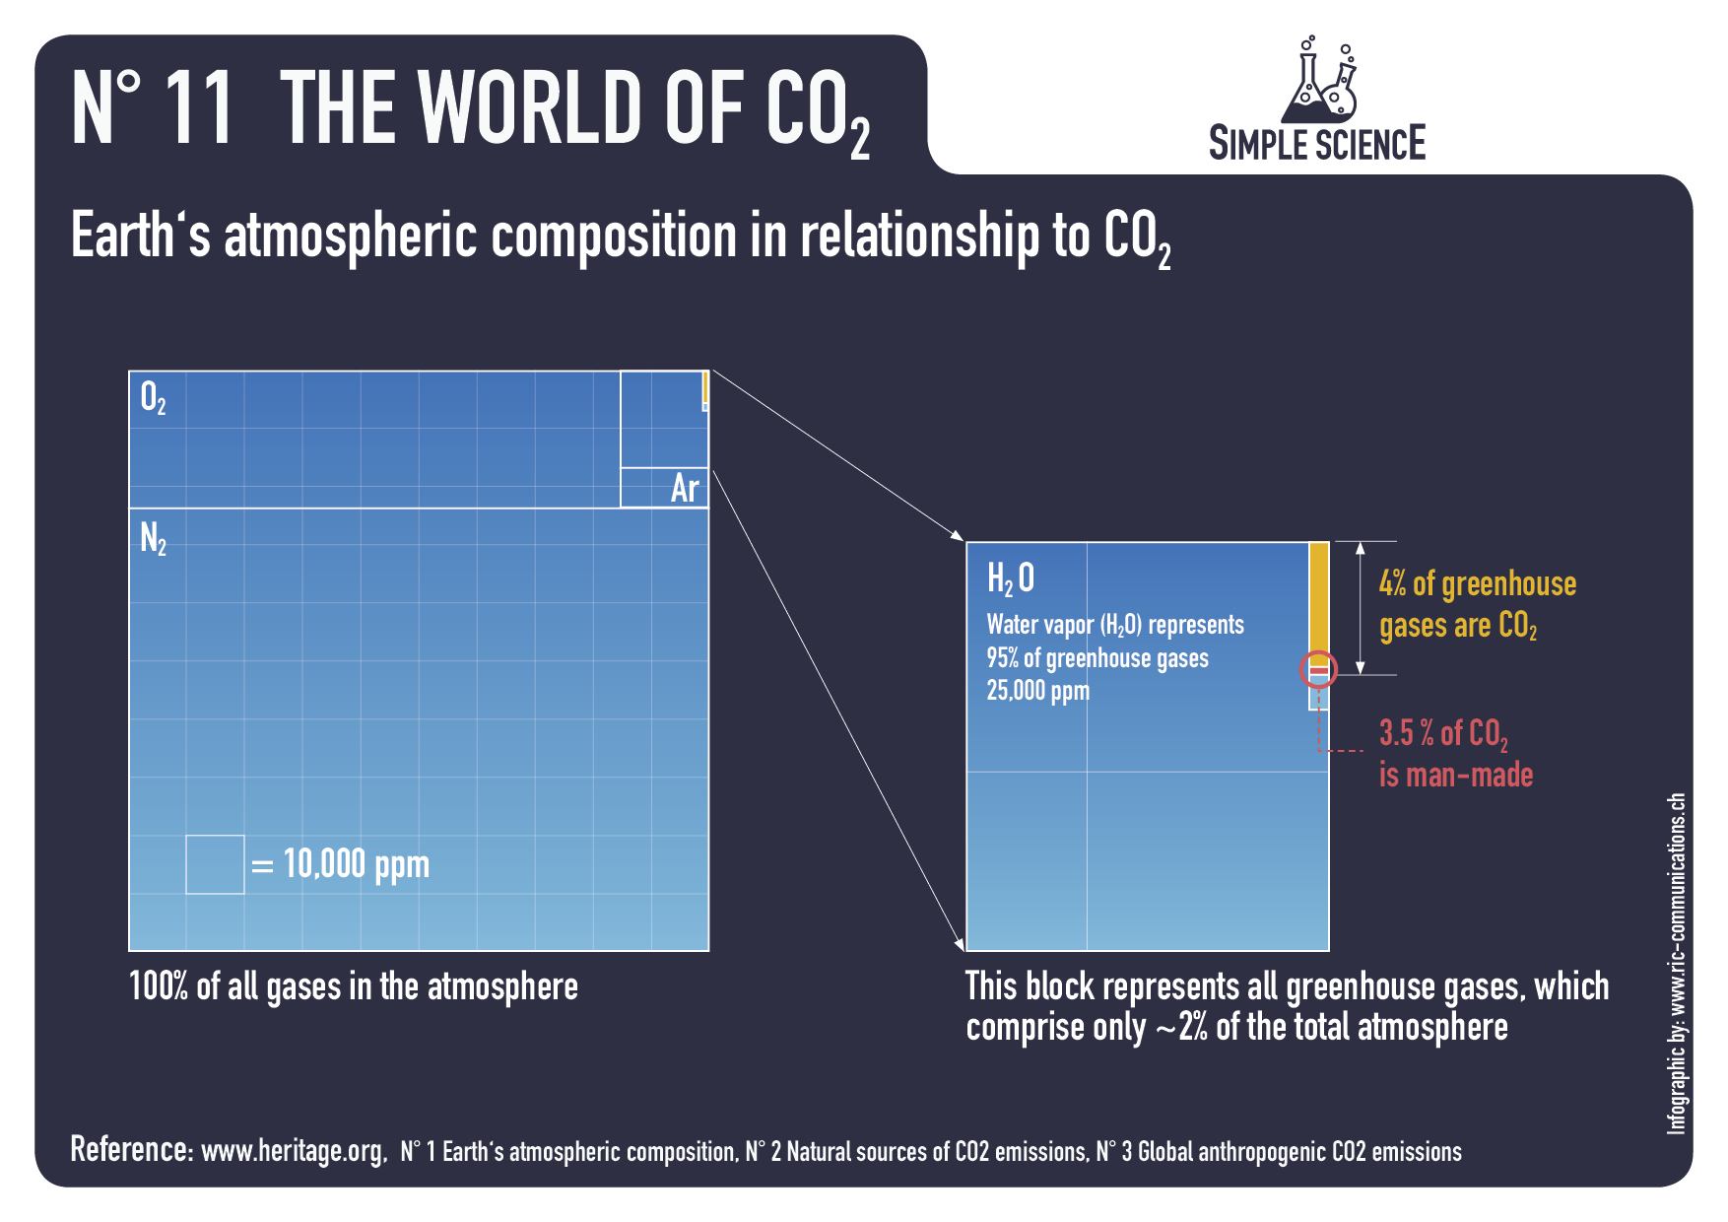
Fig.11: How potent a transient IR absorber is atmospheric CO₂?- Part 1

Slide 16
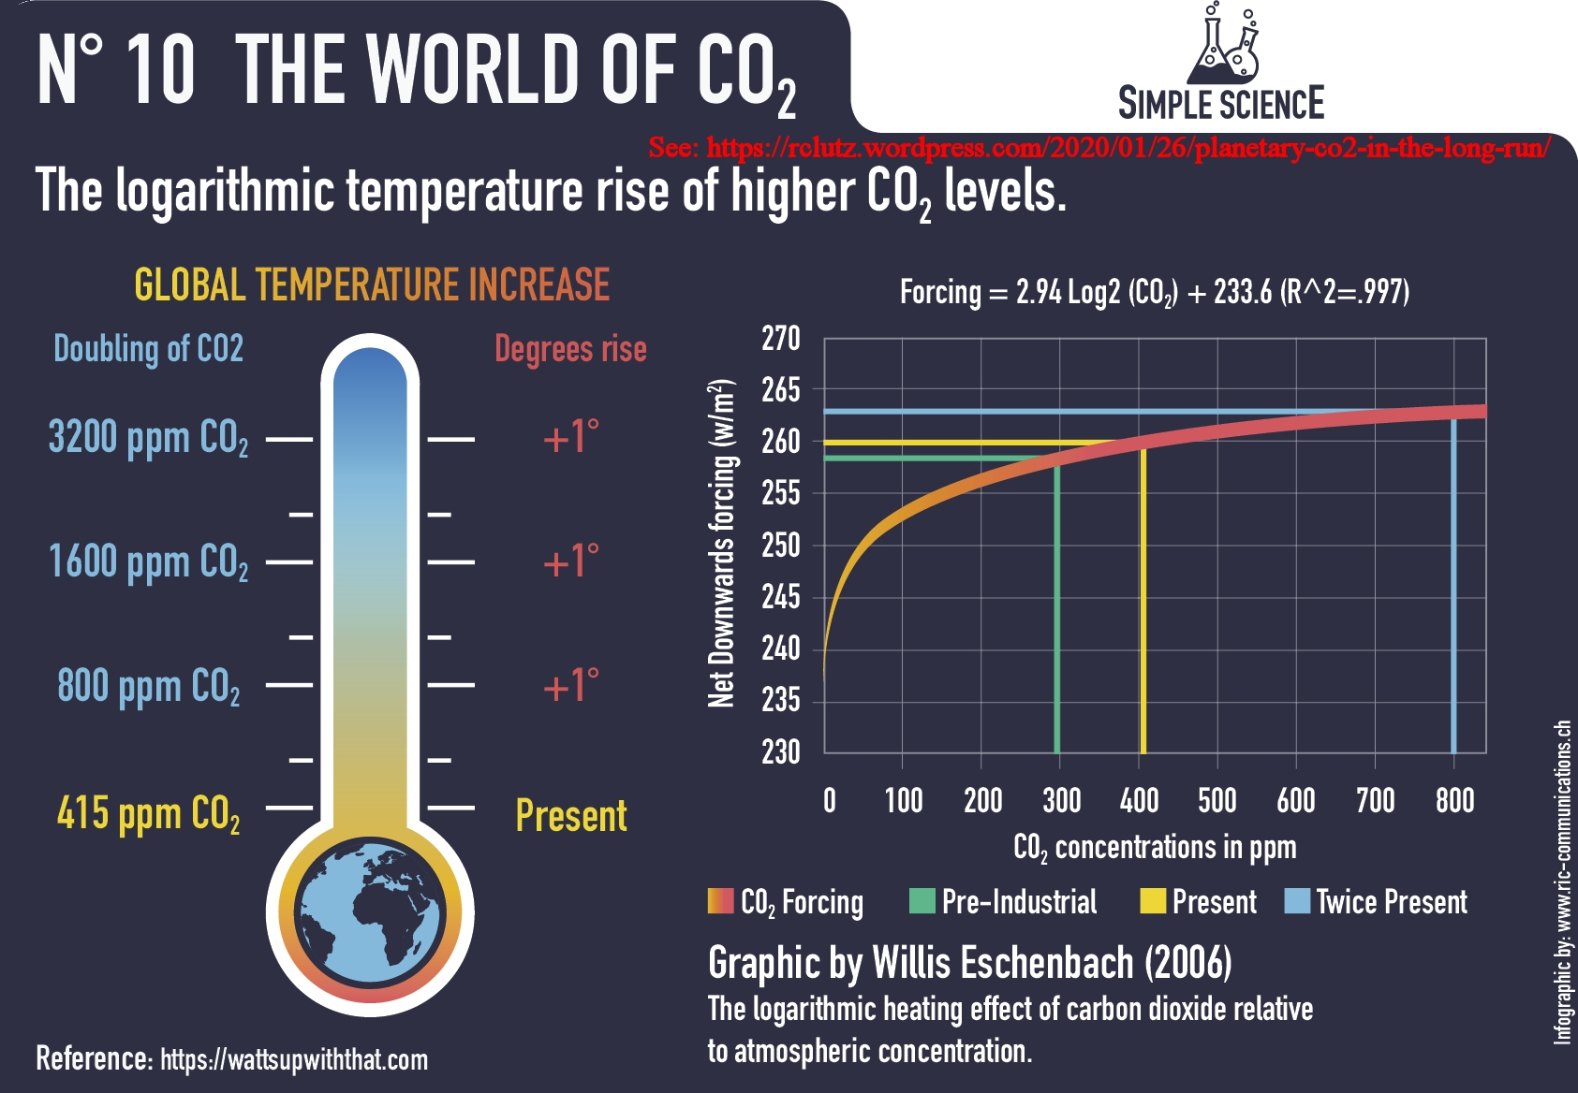
Fig.12: How potent a transient IR absorber is atmospheric CO₂?- Part 2

Slide 17
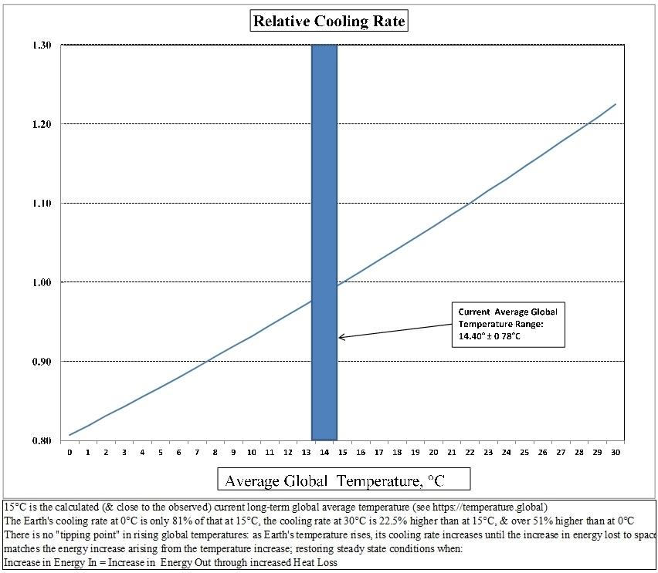
Fig.13: There’s NO ‘Tipping Point’

Slide 18
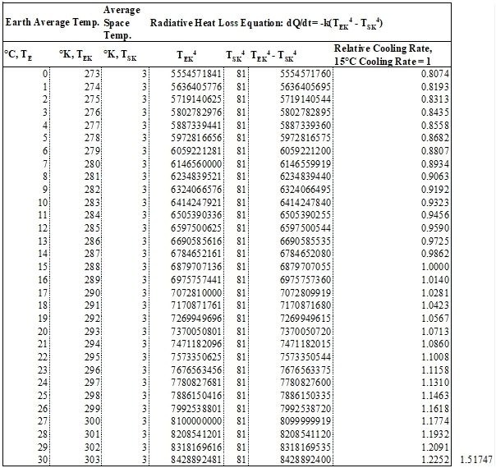
Fig.14: The Maths
Radiative Heat Loss Equation: dQ/dT = -k(T⁴_{EK} – T⁴_{SK})

Slide 19
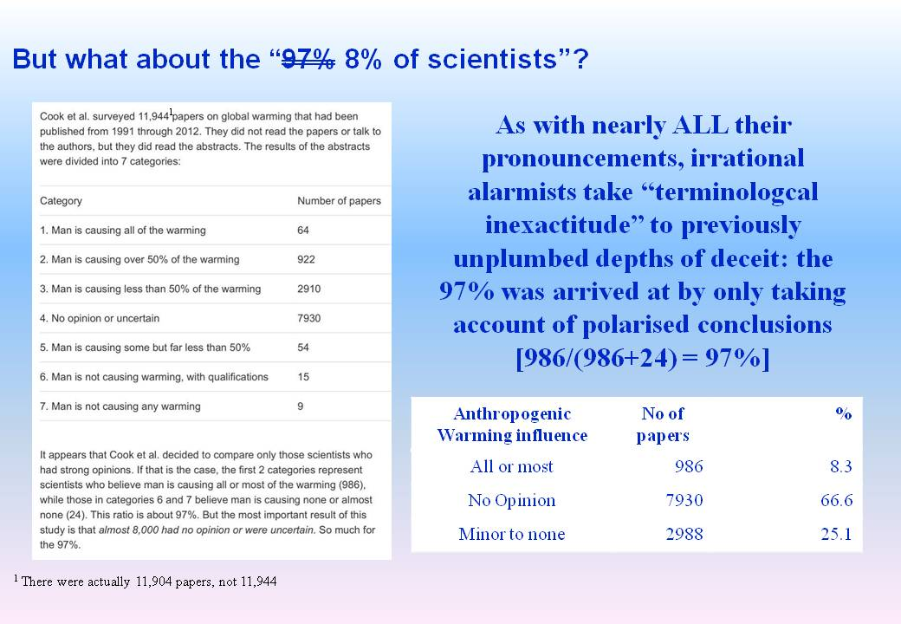
Fig.15: But the “science” is “settled”, isn’t it?

Slide 20
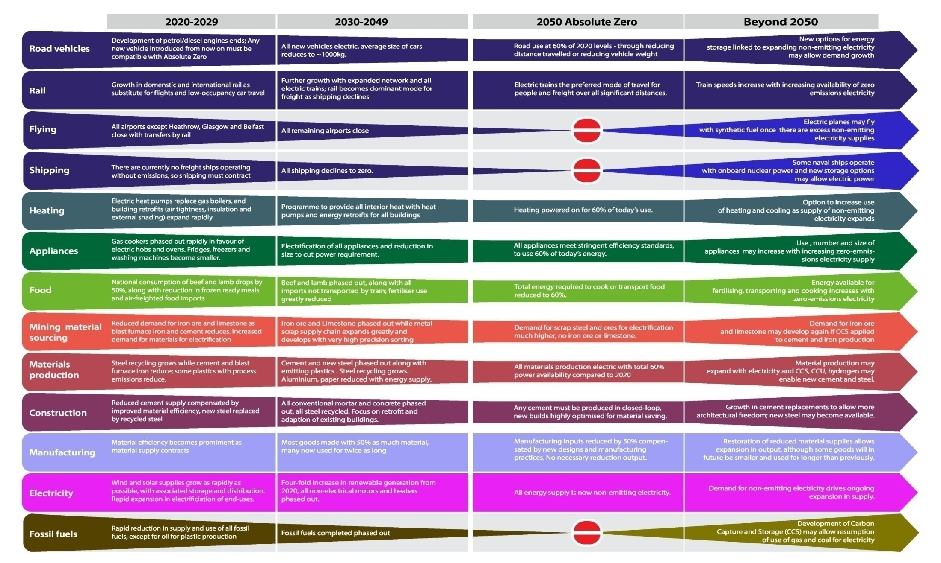
Fig.16: This is what the élite has planned for the plebs (us)

Slide 21

Fig.17: Is Net Zero worth the effort anyway

Slide 22
Fig.18: The Inconvenient Facts about Net Zero
References:
IPCC's climate computer model, MAGICC (https://www.magicc.org), estimates that if the entire world immediately adopted a Net Zero strategy now, the effect on global temperatures would: (a) not be more than 0.1°C by 2050, and (b) not be more than 0.2°C by 2100 (See: https://www.cfact.org/2020/03/03/eliminate-fossil-fuels-now-u-s-climate-model-says-why-bother/).
The UK is responsible for <1.2% (& falling) of Man-made atmospheric CO₂ emissions (https://wattsupwiththat.com/2019/06/19/global-man-made-co2-emissions-1965-2018-bp-data/); so at most an (unmeasurable) 0.002°C temperature reduction.
UK Net Zero costs estimates vary between 1.7 trillion (about £2,000 per household per annum for 30 years) by Net Zero Watch https://www.netzerowatch.com/cost-of-net-zero-will-be-astronomical-new-reports-warn/) & 7.5% of GDP (McKinsey https://www.conservativewoman.co.uk/revealed-the-true-cost-of-net-zero-insanity-18000-a-year-for-every-household/), representing £15 Trillion (£18,000 per household per annum) over the same period.
Yet the World Bank itself (https://www.worldbank.org/en/news/feature/2011/06/06/economics-adaptation-climate-change) estimates that simply adapting to changes in climate - instead of futile attempts to control them - will only cost a maximum of $100Bn per annum GLOBALLY between now and 2050: $2.7 Trillion.
The UK's projected Net Zero implementation cost is nearly SEVEN TIMES that of a global adaptation-only climate change strategy.
Based on a projected UK maximum 0.002°C temperature reduction contribution, and a UK Net Zero implementation cost of £500Bn per annum over three decades, that works out at an insane £7.5 THOUSAND TRILLION per °C temperature reduction. Sound like money well spent; when doing nothing would "only" cost £2.7 Trillion GLOBALLY?
Calculation:
UK NZ Cost = £5x10¹¹ x 30 = £1.5x10¹³
Estimated Resultant Temperature Reduction = 0.002°C
Cost per °C Temperature Reduction = £1.5x10¹³/0.002 = £7.5x10¹⁵: £7,500 Trillion

Slide 23
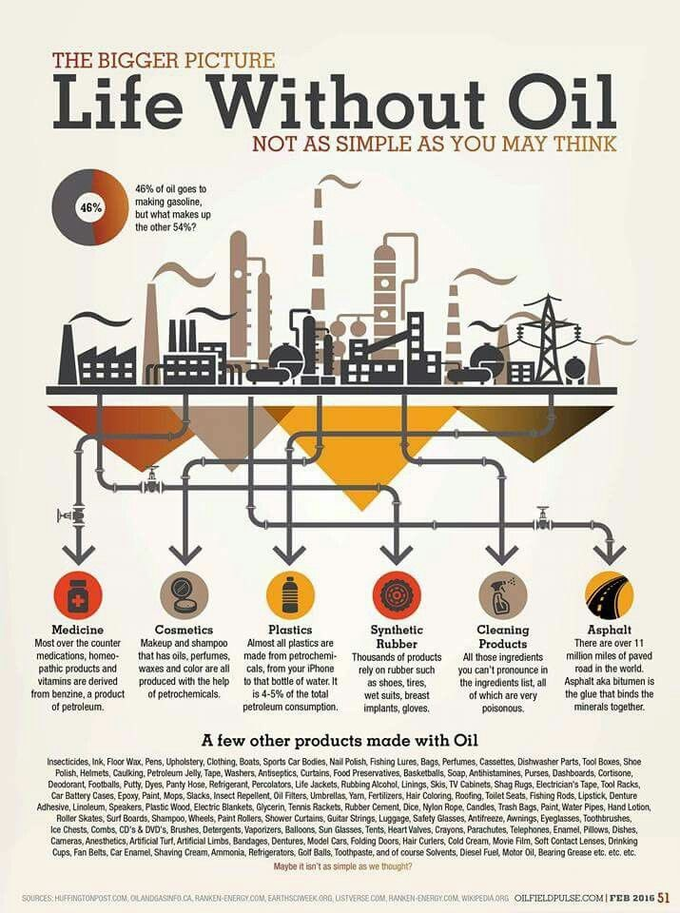

Fig.19: Think we can dispense with fossil fuels? Only if we regress to feudal climate serfdom

Slide 24
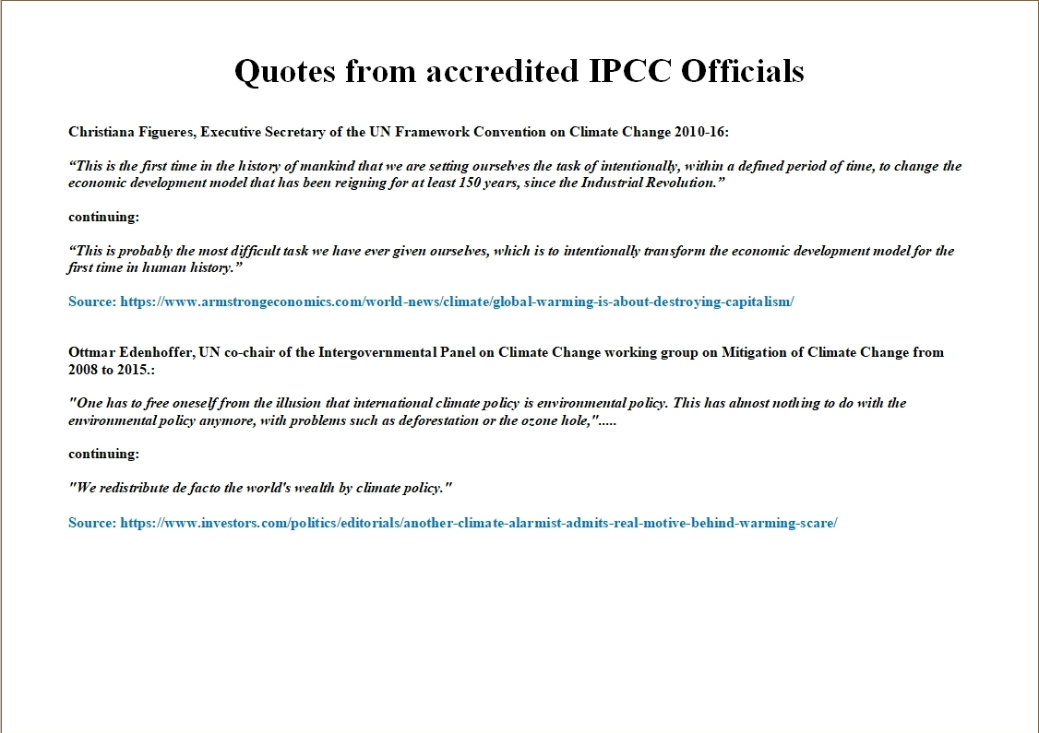
Fig.20: Real aims of purported climate management policies

Slide 25
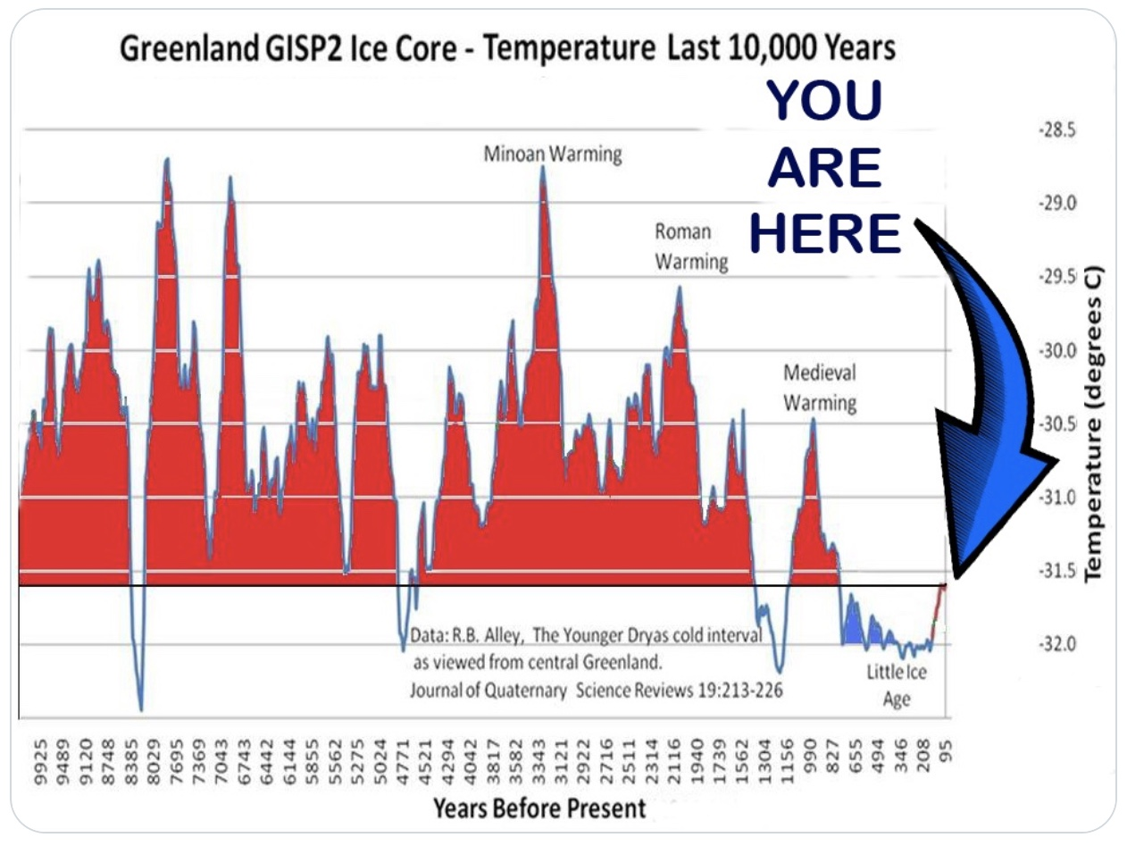
Fig.21: Historical Temperature Records
See also: https://www.youtube.com/watch?v=L1mjG_F8ppw

Slide 26
Fig.22: In the words of Jorgen Peder Steffensen.....
We live in Cold Times:
https://youtu.be/WE0zHZPQJzA

Slide 27
Fig.23: Why the ICE vehicle sales phaseout is inappropriate
It won't affect temperature or Climate.
It will hurt motorists in their pockets.
It will result in UK & European Job Losses.
It will enable China to further its plan to supplant Western Manufacturing.
The technology and infrastructure aren’t in place to support BEVs, nor their inherent inextinguishable fire risk.
It is an ideological solution to a non-existent problem.
In a free country, you can’t control consumers' decisions by diktat.

Slide 28
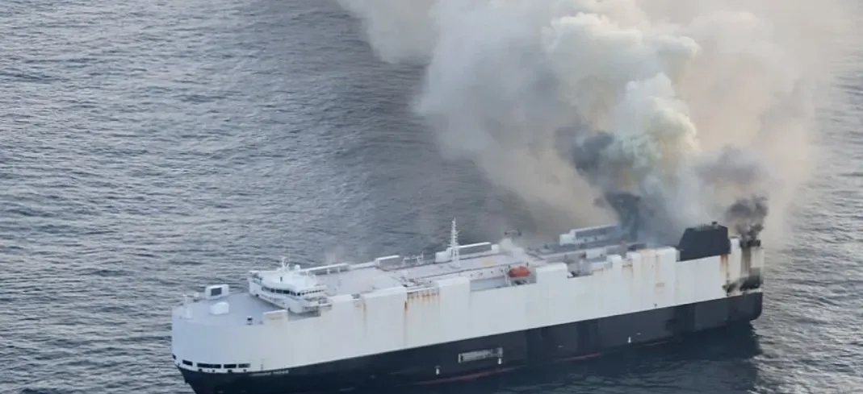
Morning Midas Fire:
Photo: US Coast Guard
See: Cargo Ship Packed with Hundreds of EVs Now a Hair's Width Away from Becoming an Ecological Catastrophe:
https://www.westernjournal.com/cargo-ship-packed-hundreds-evs-now-hairs-width-away-becoming-ecological-catastrophe/

Slide 29


Slide 30

The Alliance of British Drivers
P.O. Box 1043, TS19 1XG
https://www.abd.org.uk
https://www.transportreality.net

Slide 31
Points 1 - 4
There is no Climate Emergency. There is a Climate Computer Modelling Emergency: almost all but one of the models (the Prof. Habibullo Abdussamatov one) exceed practical observations by several Fergusons (Slide 5, Fig.1. Data from Dr. John Christy per chart).
The accurate satellite-measured global average temperature record for the last 50 years shows barely discernible warming on any meaningful scale (Slides 6-7, Figs. 2 & 3. data from: https://www.drroyspencer.com/latest-global-temperatures/) plotted on a 30°C to -6°C; 12°C average temperature scale, typical of the UK annual temperature range).
Despite blatant NASA/ NOAA temperature data record falsification, scientifically-valid evidence of “global boiling” is notable for its absence (see: https://temperature.global/):14.1°C average temperature from 69,961 temperature readings; only 86°C to go!!! (Slide 8, Fig.4)
Over the approaching 10,000 years since the last Ice Age ended, Earth has endured numerous Warm and Cold periods due entirely to natural climate variations. The current Modern Warm Period is in no way inconsistent with the previous Minoan, Roman and Medieval Warm Periods. The latter period was when the Vikings settled Greenland, and petrified tree stumps in the far north of Canada show they were growing in a temperate climate; warm enough ‘up there’ to cultivate, no less. The worry is that there is a downward trend in these peaks, possibly presaging the slide towards another Ice Age. Runaway warming is highly improbable. (Slide 9, Fig.5. Data: R.B. Alley, "The Younger Dryas cold interval as viewed from Central Greenland", Journal of Quaternary Science Review, 19: p.213-226).

Slide 32
Points 5 - 9
Almost all the temperature variation since 1750 is accounted for by superposing the De Vries solar & AMO/PDO oceanic activity cycles (Slides 9-10: H.-J. Luedecke, A. Hempelmann & C.O. Weiss: Page 451, Fig.6: “Multi-periodic climate dynamics: spectral analysis of long-term instrumental and proxy temperature records”; Climate of the Past: https://www.semanticscholar.org/paper/Multi-periodic-climate-dynamics%3A-spectral-analysis-L%C3%BCdecke-Hempelmann/12a0363dd89267f4d5d07bf6fa94e30f70a4b6ad
(Slides 10 & 11, Figs.6 &7)
But don't "97% of scientists" say there's a "climate crisis"? No, only 8% do (probably all those whose funding depends on it), nearly 67% don't have any firm opinion, and 25% contend there isn't one (Slide 12, Fig.8).
CO₂ is a minor global warming gas (GWG). Atmospheric water vapour is the most potent abundant GWG: there is c.60 times more of it than CO₂ and it's c.7 times more potent, molecule-for-molecule than CO₂ (Slide 13, Fig. 9. Reference URL on slide).
The effect of increases in atmospheric CO₂ concentration is logarithmically declining; each 0.5°- 1°C requires a minimum doubling of atmospheric CO₂ concentration (Slide 14, Fig.10. Reference on slide). Latest research suggests forcing could be as little as ≤ 0.5°C even at 1600ppmv atmospheric CO₂ concentration (https://climatechangedispatch.com/new-report-finds-quadrupling-co2-would-lead-to-only-1-0c-increase/). There isn't enough chemically-accessible CO₂ in the terrestrial eco-system to support 800ppmv atmospheric CO₂; let alone the c.3200 ppmv levels required to reach 2° to 3°C above current temperatures.
The Net Zero Policy Suite has not been subjected to any detailed Environmental or Socio-economic Impact
Assessments, nor to any comprehensive cost-benefit analysis or any genuine Parliamentary scrutiny. Nor has public been adequately informed of its lifestyle implications (Slide 15, Fig.11: Ref.: https://www.repository.cam.ac.uk/bitstream/handle/1810/299414/REP_Absolute_Zero_V3_20200505.pdf?sequence=9&isAllowed=y, p.6.).

Slide 33
Points 10 - 13
Even if the entire world were to fully adopt the Net Zero strategy NOW (which China, India, Russia and the entire developing world definitively will not), it would only reduce the global temperature by a maximum of 0.2°C by 2100 (Slide 16, Fig.12)
Based on a projected UK maximum 0.002°C temperature reduction contribution, and a UK Net Zero implementation cost of £500Bn per annum over three decades (£15 TRILLION), that works out at £7.5 THOUSAND TRILLION per °C temperature reduction. Yet the World Bank itself estimates that simply adapting to changes in climate - instead of futile attempts to control them - will only cost $100Bn maximum per annum to 2050 ($2.7 Trillion). The UK's projected Net Zero implementation cost is some SEVEN TIMES that of a global adaptation-only climate change strategy (Slide 17, Fig.13. References on slide).
There are some 6,000 essential products (Slide 18, Fig.14, references on slides), without which modern society cannot function, that would rapidly become unavailable should we cease the exploitation of fossil fuel technology.
The IPCC is a political, not a scientific body, that has unilaterally hi-jacked the climate change issue for the purposes of changing the global socio-economic system (dismantling the free enterprise capitalism model) and redistributing global wealth. It has no democratic mandate to carry out either of these tasks (Slide 19, Fig.15).

